Slide 1



Keyword Gap Analysis
x
Interactive Competitive Intelligence

Slide 2

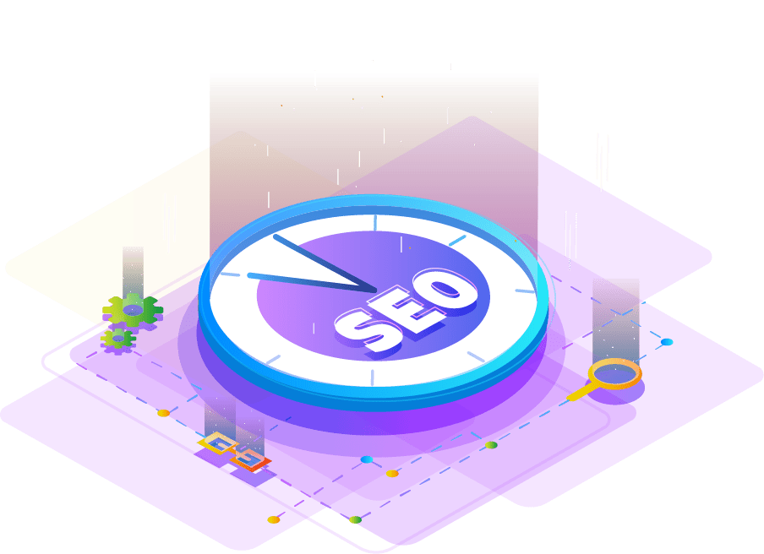
The Concept
In most markets, there are organizations who have “been there, and done that.” While sometimes, that can be considered a disadvantage, we see it differently.
The Keyword Gap Analysis works to uncover what is working for a strategically-selected set of industry search competitors, and the final deliverable allows us to uncover keyword opportunities we otherwise would have missed.
These keywords will drive strategy for new content for your website - from resource pages to product and service pages.

Slide 3

Your Competition
We agreed on a select set of competitors. At a high-level, here are their metrics:
You
Comp 1
Comp 2
Comp 3
Comp 4
Comp 5
Logo
Logo
Logo
Logo
Logo
Logo
1.5k Visitors/mo
1.5k Visitors/mo
1.5k Visitors/mo
1.5k Visitors/mo
1.5k Visitors/mo
1.5k Visitors/mo
2.8k Keywords
2.8k Keywords
2.8k Keywords
2.8k Keywords
2.8k Keywords
2.8k Keywords
300 Top-3 Keywords
300 Top-3 Keywords
300 Top-3 Keywords
300 Top-3 Keywords
300 Top-3 Keywords
300 Top-3 Keywords

Slide 4
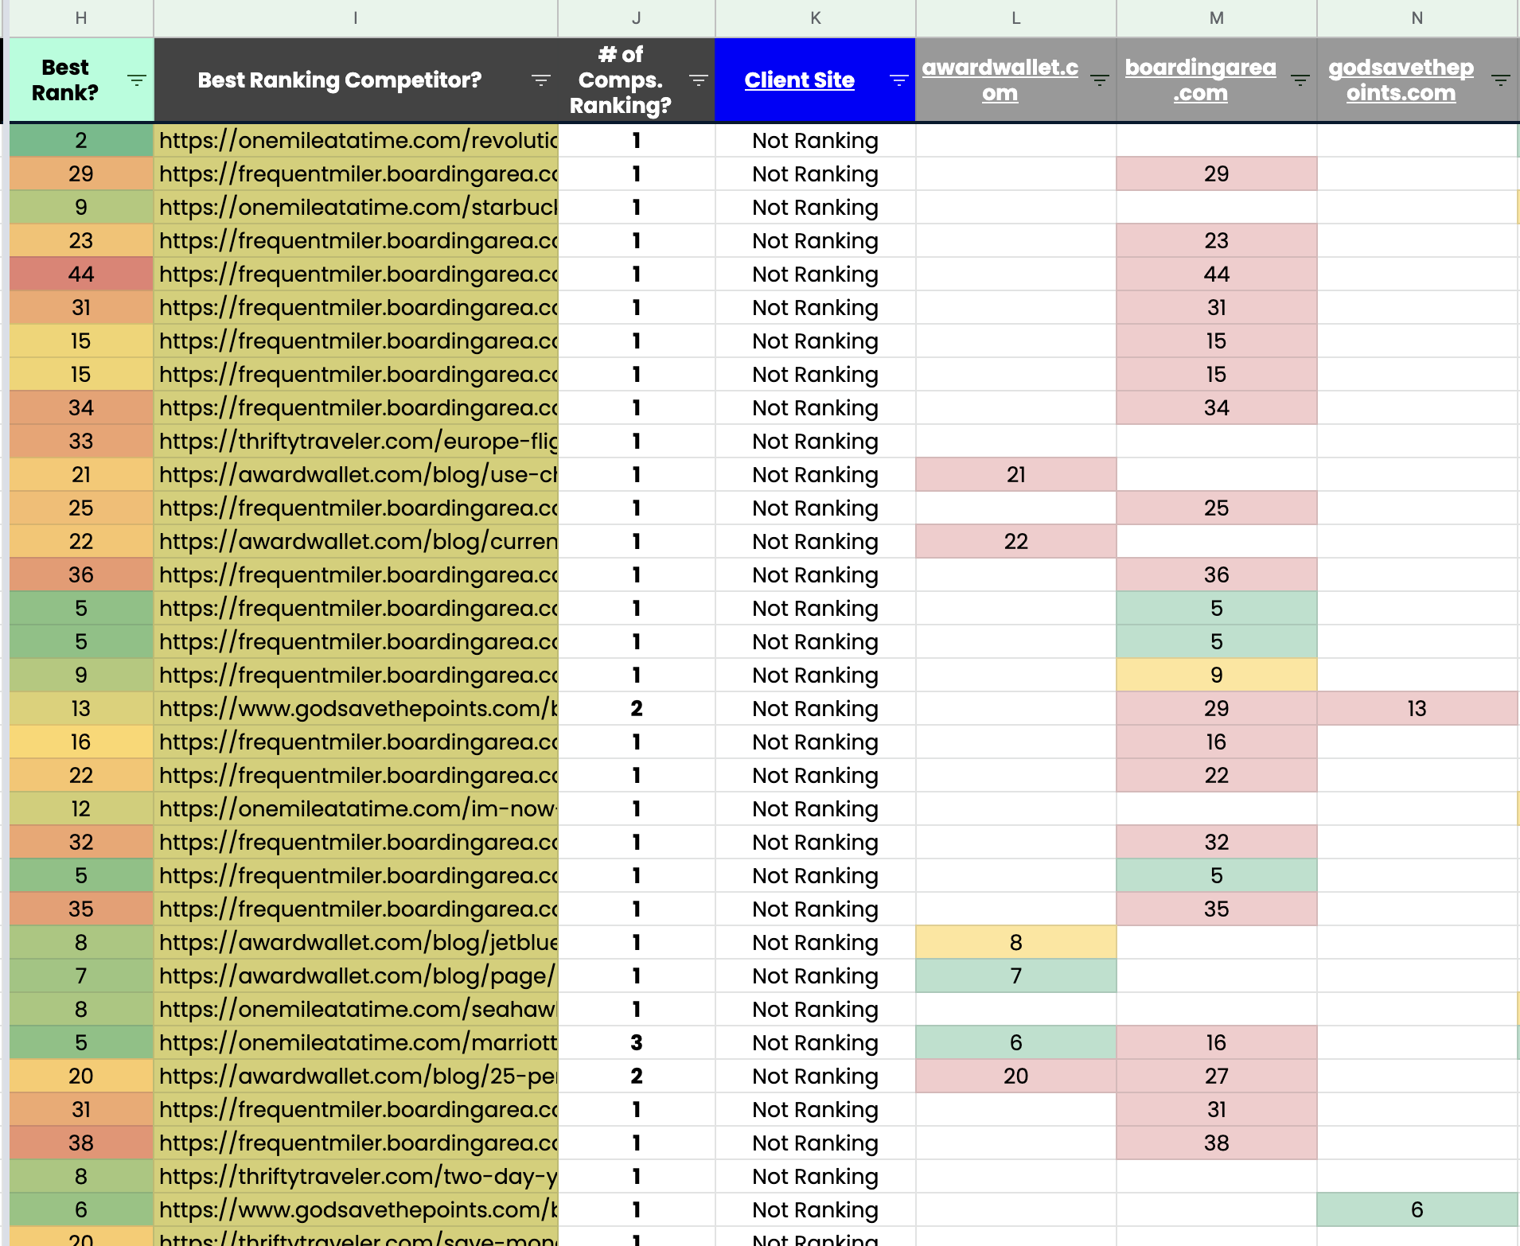
The Process Step 1: Gathering The Data
We start by scraping a list of keywords your competitors are ranking for.
We take your competitor rankings and blend that with your rankings to create a comparative report.
We use this data to sort keywords for which you’re not currently ranking well.

Slide 5
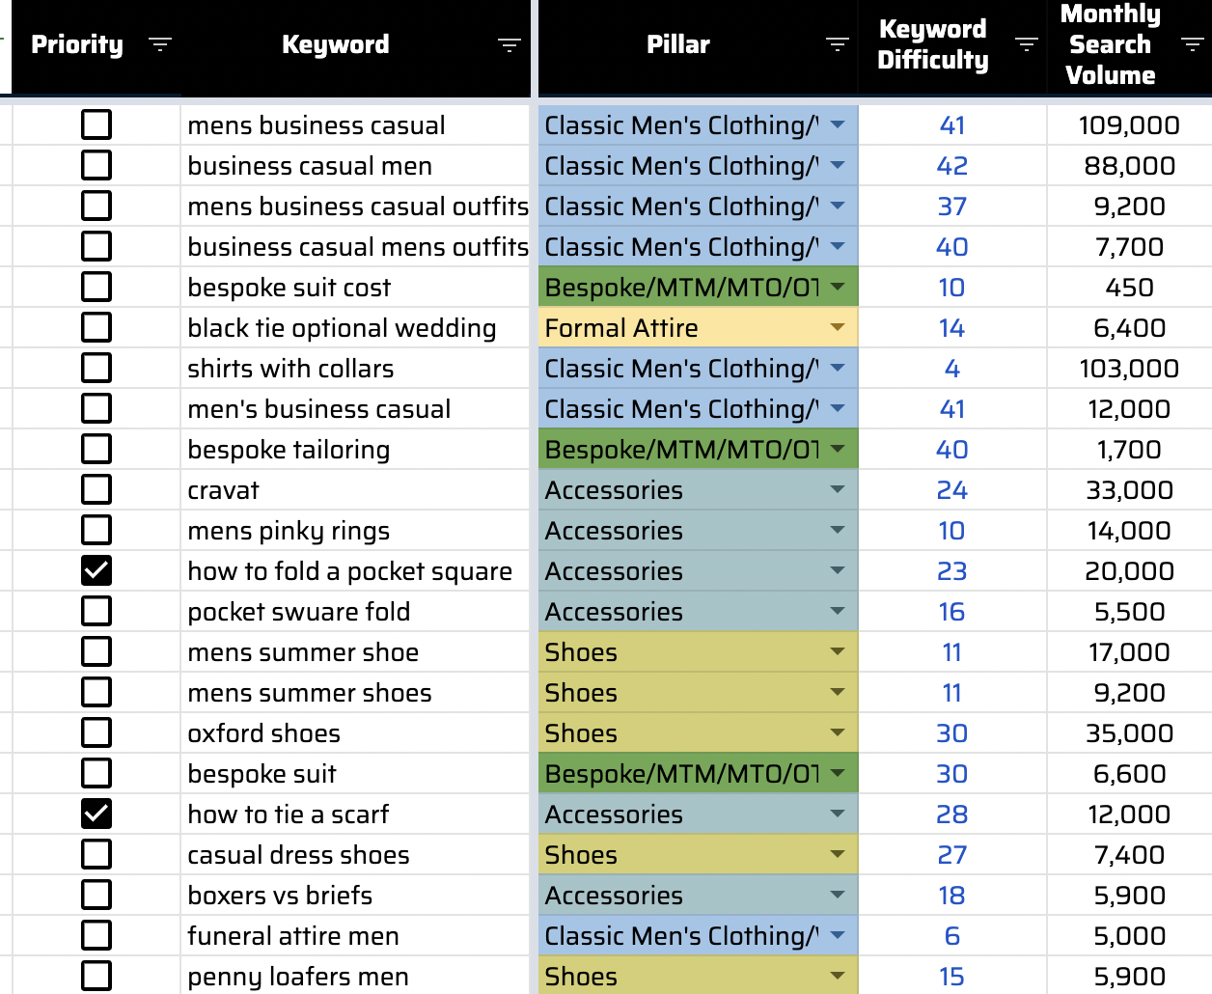
The Process Step 2: Cleanup & Analysis
After we have the data available, we manually check each keyword and discard those which are not relevant.
We then go through the refined keyword list to perform an analysis on how your keyword rankings currently stack up against your competitors, and identify where there are opportunities.

Slide 6


What We Learned

Slide 7
How To Use Gap Analysis
Notes:
[This Slide does not require edits - this step is used during hte presentation to segway to the Google Sheets deliverable, and walk the client through how to use it].

Slide 8
Organic Opportunity Analysis
US Market Organic Opportunity Analysis Assumptions
$700 Average Order Value
2.2% Organic Conversion Rate (Based on Organic Purchase CVR, excluding Article pages)
US Market
Existing Ranking Keywords in #6 or lower, excluding Blog pages (with exception of KWs listed in Slide Note).
Keyword Gaps with three large competitors: withlocals.com, getyourguide.com, toursbylocals.com
Targeting #2-3 (on average) in Google
The analyzed keyword list is focused on known organic opportunities for lower funnel/high intent landing pages and keywords. There is substantial organic ROI opportunity due to the number of destinations worldwide trips are offered.

Slide 9
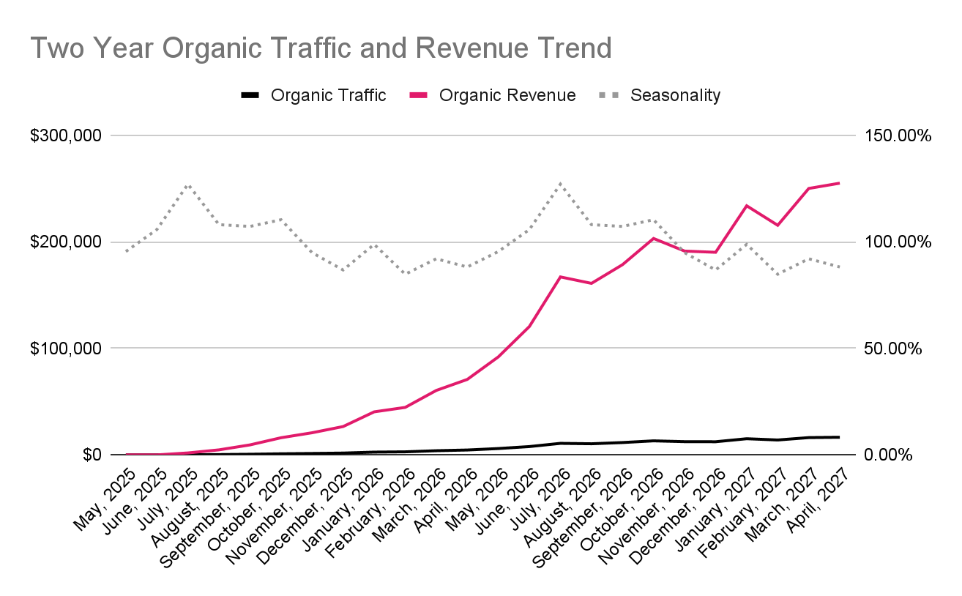
Organic Opportunity Analysis
$1,685,545 / mo. Target Organic Revenue Opportunity in US Market
Opportunity Analysis Scenario Insights
$40,433/mo. Incremental Revenue Starting End of Campaign Y1
Positive Total ROI Starting in Q4 of First Year
Notes:
Include Link to KW Spreadsheet “Visualization” Chart Here: https://docs.google.com/spreadsheets/d/1gYArCMciBryBr-b9YoBx0xNqtkRTTgNtLUGWGxMN2_0/edit?gid=1845782846#gid=1845782846

Slide 10
Main Takeways
In this slide, please record some of your main takeaways from the KW Gap Analysis.
This can include anything from
What keywords competitors rank in the top 10 positions for, that your client does not
Keywords that are valuable for future content
Keywords that the client does rank well for
Keywords that you do not see as opportunities, and should be avoided
Overall verticals/themes you see potential for creating content
Please duplicate this slide as needed to create a presentation for your main takeaways.

Slide 11
Keyword Gaps and Opportunities
The following table contains keywords [Client] currently ranks at the bottom or just outside of the first page of search results. If any of the following terms are valuable, our SEO efforts will be put towards optimizing content & building authority for these low-hanging fruit to get them to the page 1:
Keyword | KD | Volume | Current Position

Slide 12
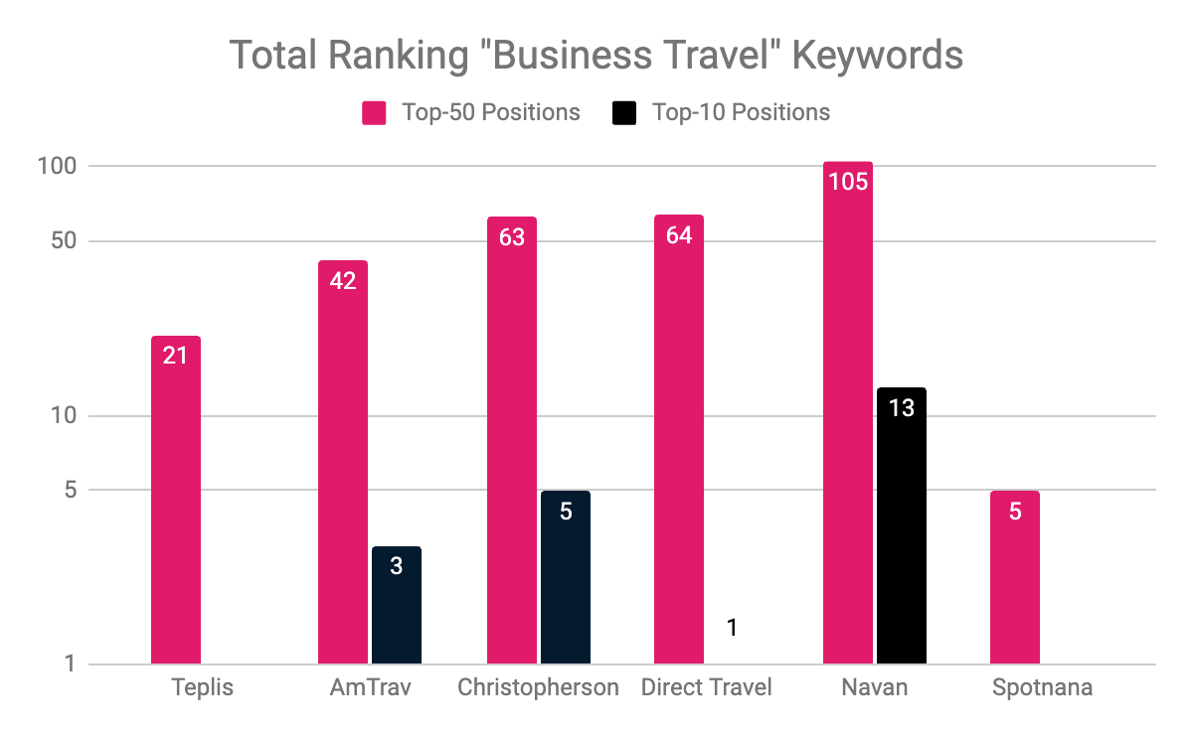
Main Takeaways:
text

Slide 13

THANK YOU!
www.propellic.com

